Slide 1
presentation begins
HERE IS WHERE YOUR

Slide 2
Contents
About us
1
Creative info
2
Data analysis
3
This is the subtitle that makes it comprehensible
This is the subtitle that makes it comprehensible
This is the subtitle that makes it comprehensible

Slide 3

Whoa!
It could be the part of the presentation where you can introduce yourself, write your email…

Slide 4
Important information
Mercury’s name has nothing to do with the liquid metal since it was named after the Roman messenger god, Mercury

Slide 5
“This is a quote. Words full of wisdom that someone important said and can make the reader get inspired.”
—Someone famous

Slide 6
1. This is a great headline
And this is the subtitle that makes it comprehensible

Slide 7
The slide title goes here!
Do you know what helps you make your point clear? Lists like this one:
Because they’re simple
You can organize your ideas clearly
And because you’ll never forget to buy milk!
And the most important thing: the audience won’t miss the point of your presentation

Slide 8
Maybe you need to divide the content
MERCURY
VENUS
Mercury is the closest planet to the Sun and the smallest one in the Solar System—it’s only a bit larger than our Moon. The planet’s name has nothing to do with the liquid metal since it was named after the Roman messenger god, Mercury
Venus has a beautiful name and is the second planet from the Sun. It’s terribly hot—even hotter than Mercury—and its atmosphere is extremely poisonous. It’s the second-brightest natural object in the night sky after the Moon

Slide 9
Maybe you need to divide the content
Mercury is the closest planet to the Sun and the smallest one in the Solar System—it’s only a bit larger than our Moon. The planet’s name has nothing to do with the liquid metal since it was named after the Roman messenger god, Mercury
Venus has a beautiful name and is the second planet from the Sun. It’s terribly hot—even hotter than Mercury—and its atmosphere is extremely poisonous. It’s the second-brightest natural object in the night sky after the Moon

Slide 10
You could use three columns, why not?
MARS
JUPITER
VENUS
Despite being red, Mars is a cold place, not hot. It’s full of iron oxide dust, which gives the planet its reddish cast
It’s a gas giant and the biggest planet in our Solar System. Jupiter is the fourth-brightest object in the sky
Venus has a beautiful name and is the second planet from the Sun. It’s terribly hot—even hotter than Mercury

Slide 11

A picture always reinforces the concept
Images reveal large amounts of data quickly, so remember: use an image instead of long texts. Your audience will appreciate that.
Venus has a beautiful name and is the second planet from the Sun. It’s terribly hot—even hotter than Mercury—and its atmosphere is extremely poisonous

Slide 12
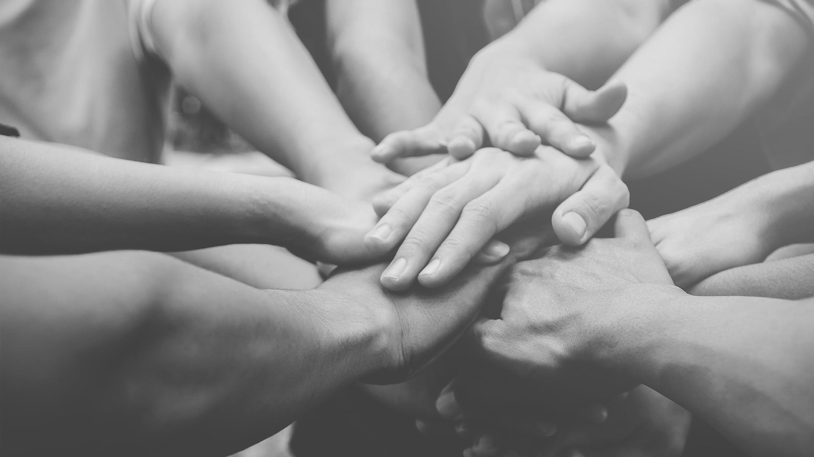
A picture is worth a thousand words

Slide 13
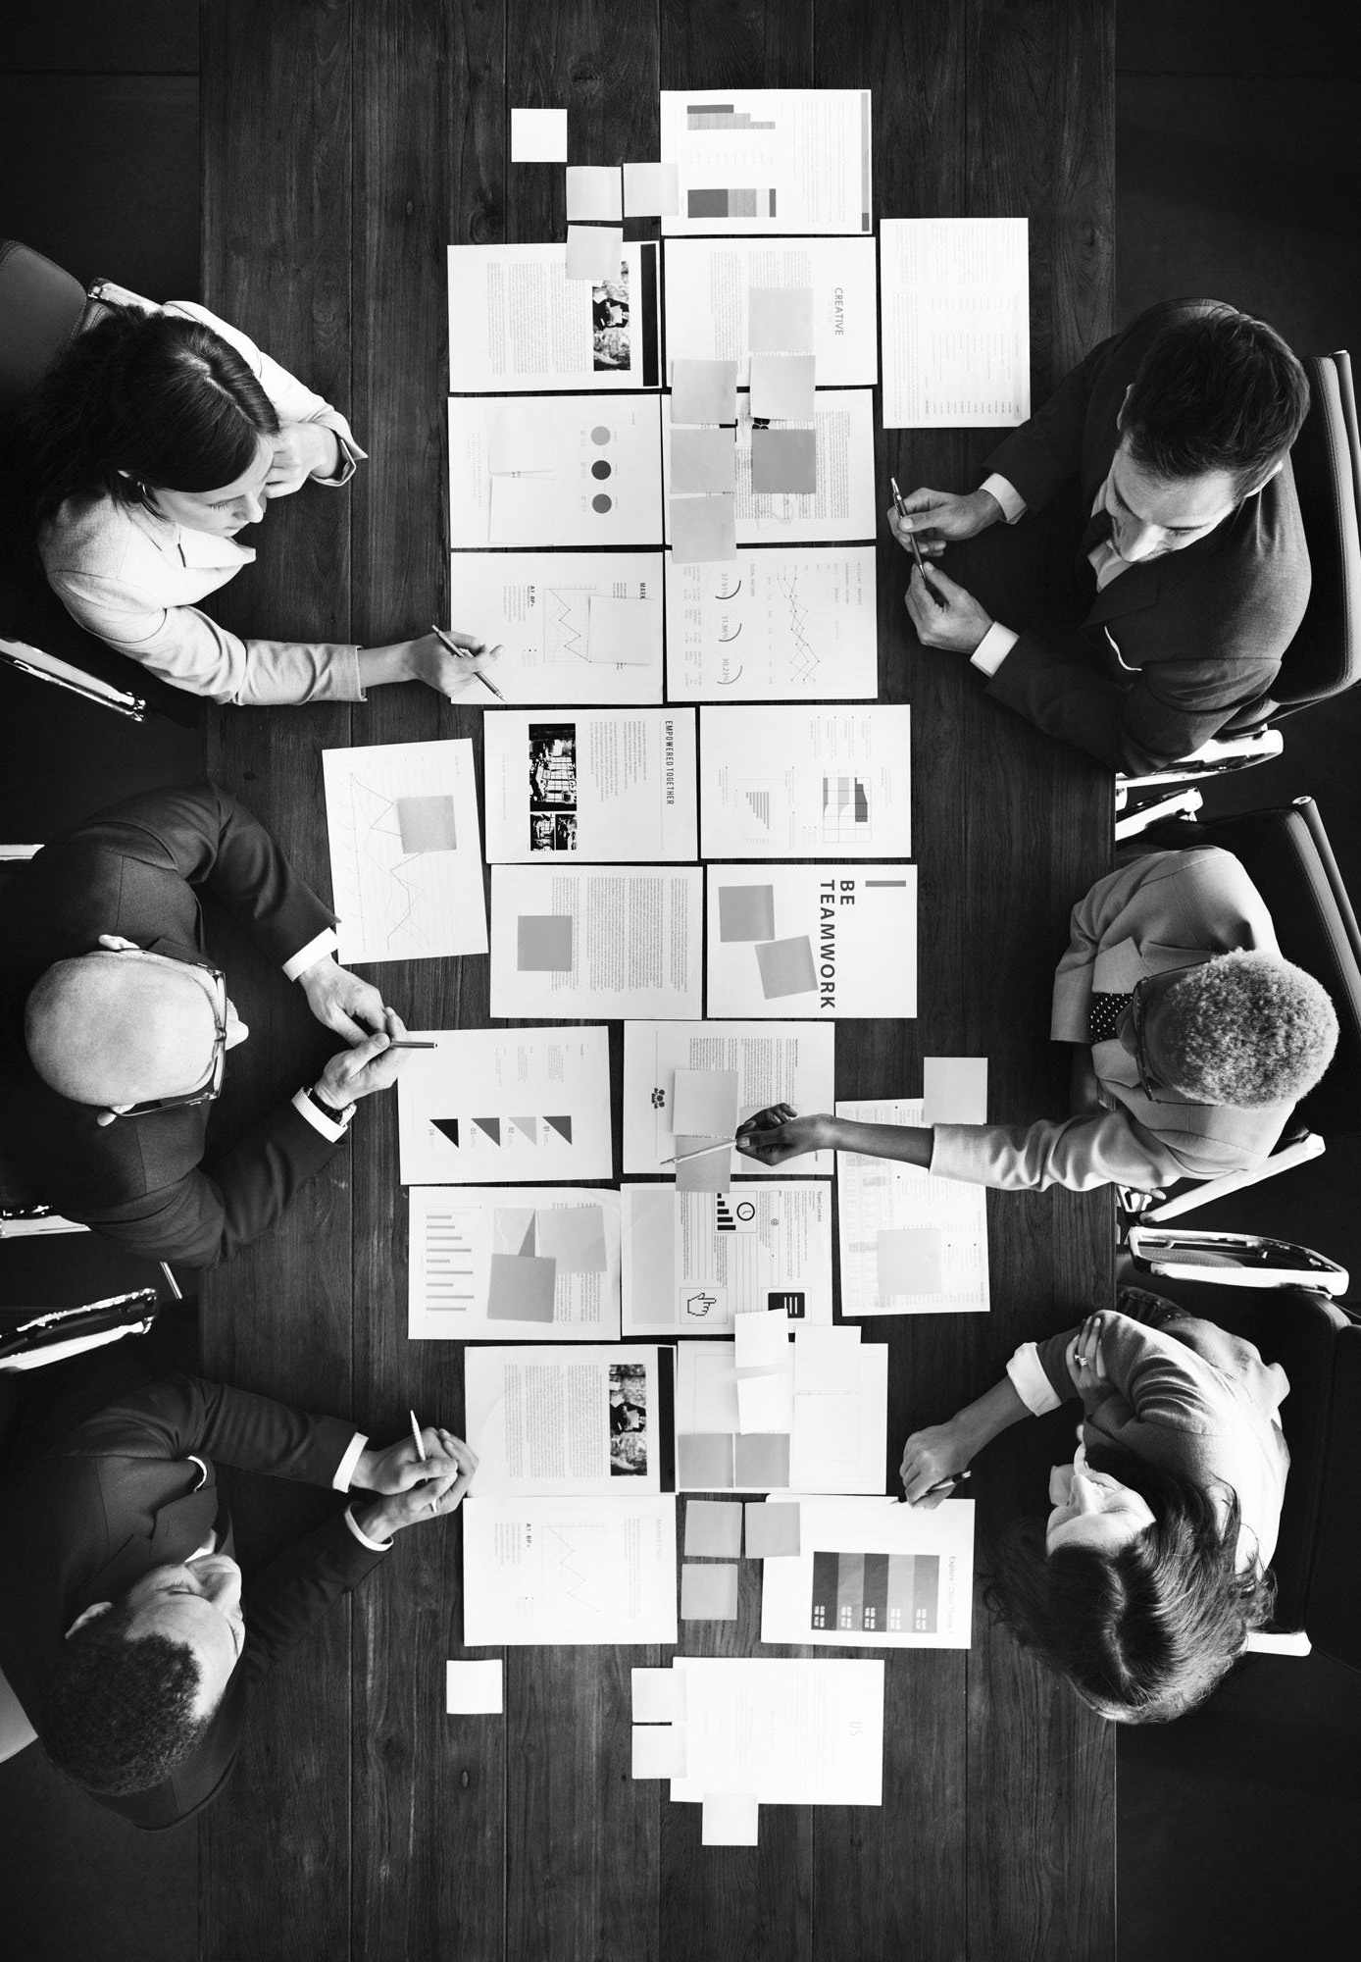
And here too!
Images reveal large amounts of data quickly, so remember: use an image instead of long texts. Your audience will appreciate that

Slide 14
Awesome words
Because key words are great for catching your audience’s attention

Slide 15
Infographics make your idea understandable…
MARS
Despite being red, Mars is a cold place, not hot
JUPITER
It’s a gas giant and the biggest planet in our Solar System
VENUS
Venus has a beautiful name, but it’s terribly hot

Slide 16
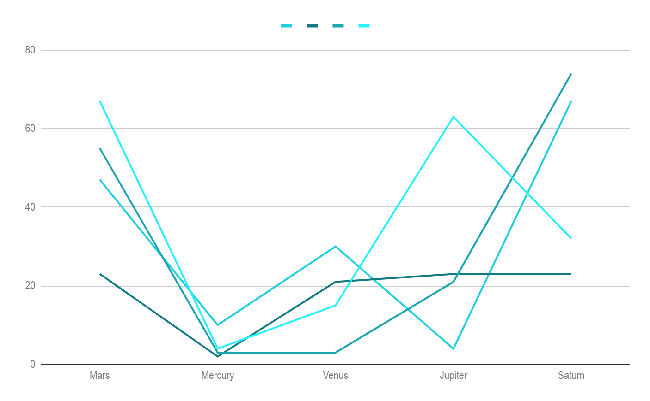
If you want to modify this graph, click on it, follow the link,
change the data and replace it
MERCURY Mercury is the closest planet to the Sun and is only a bit larger than our Moon
JUPITER It’s a gas giant and the biggest planet in our Solar System
MARS Despite being red, Mars is a cold place, not hot. The planet is full of iron oxide dust
VENUS Venus has a beautiful name, but it’s terribly hot, even hotter than Mercury
‹#›

Slide 17
… and the same goes for tables
 | MASS (earths) | DIAMETER (earths) | SURFACE GRAVITY (earths)
MERCURY | 0,06 | 0,38 | 0,38
MARS | 0,11 | 0,53 | 0,38
SATURN | 95,2 | 9,4 | 1,16

Slide 18
This is a map

Slide 19
A timeline always works fine
DAY 1
DAY 3
DAY 5
Mercury is the smallest planet in our Solar System
Despite being red, Mars is a cold place, not hot
Saturn is composed mostly of hydrogen and helium
DAY 2
DAY 4
Venus has a beautiful name, but it’s terribly hot
Jupiter is the biggest planet in our Solar System

Slide 20
4,498,300,000
Big numbers catch your audience’s attention

Slide 21
333,000.00
24h 37m 23s
386,000 km
earths is the Sun’s mass
is Jupiter’s rotation period
is the distance between the Earth and the Moon

Slide 22
Sometimes, reviewing concepts is a good idea
MERCURY
VENUS
MARS
JUPITER
SATURN
NEPTUNE
Mercury is the closest planet to the Sun and is only a bit larger than our Moon
Venus has a beautiful name, but it’s terribly hot, even hotter than Mercury
Despite being red, Mars is a cold place, not hot. The planet is full of iron oxide dust
It’s a gas giant and the fourth-brightest object in the sky
Yes, this is the ringed one. It’s a gas giant, composed mostly of hydrogen and helium
Neptune is the farthest planet in our Solar System and the fourth-largest

Slide 23
Sometimes, reviewing concepts is a good idea
VENUS Venus has a beautiful name and is the second planet from the Sun. It’s terribly hot
MARS Despite being red, Mars is a cold place, not hot. The planet is full of iron oxide dust
SATURN Yes, this is the ringed one. It’s a gas giant, composed mostly of hydrogen and helium
NEPTUNE Neptune is the farthest planet in our Solar System and also the fourth-largest

Slide 24
Your services
MERCURY
VENUS
Mercury is the closest planet to the Sun and the smallest one in the Solar System—it’s only a bit larger than our Moon. The planet’s name has nothing to do with the liquid metal since it was named after the Roman messenger god, Mercury
Venus has a beautiful name and is the second planet from the Sun. It’s terribly hot—even hotter than Mercury—and its atmosphere is extremely poisonous. It’s the second-brightest natural object in the night sky after the Moon

Slide 25
More services
MARS
JUPITER
VENUS
Despite being red, Mars is a cold place, not hot. It’s full of iron oxide dust, which gives the planet its reddish cast
It’s a gas giant and the biggest planet in our Solar System. Jupiter is the fourth-brightest object in the sky
Venus has a beautiful name and is the second planet from the Sun. It’s terribly hot—even hotter than Mercury

Slide 26
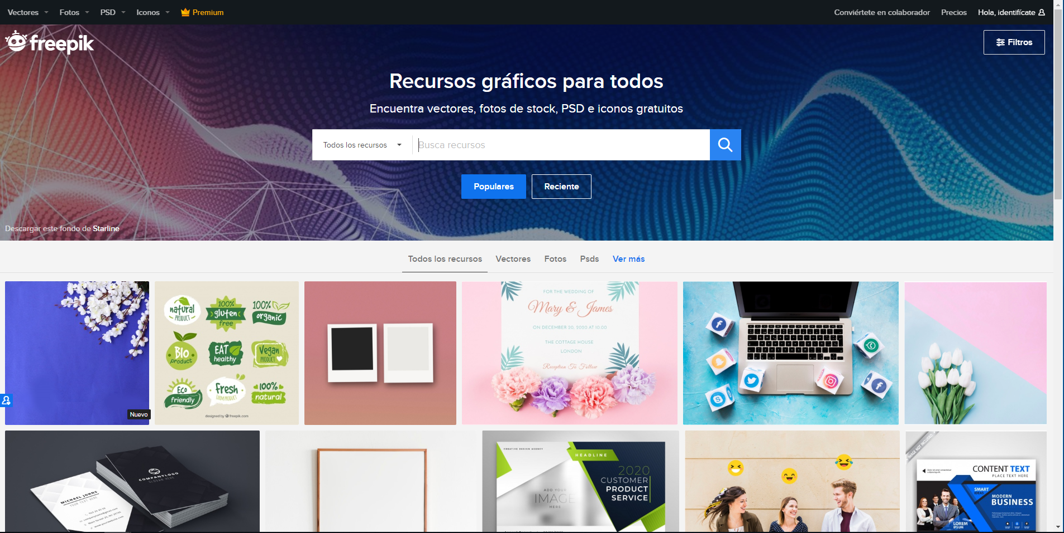
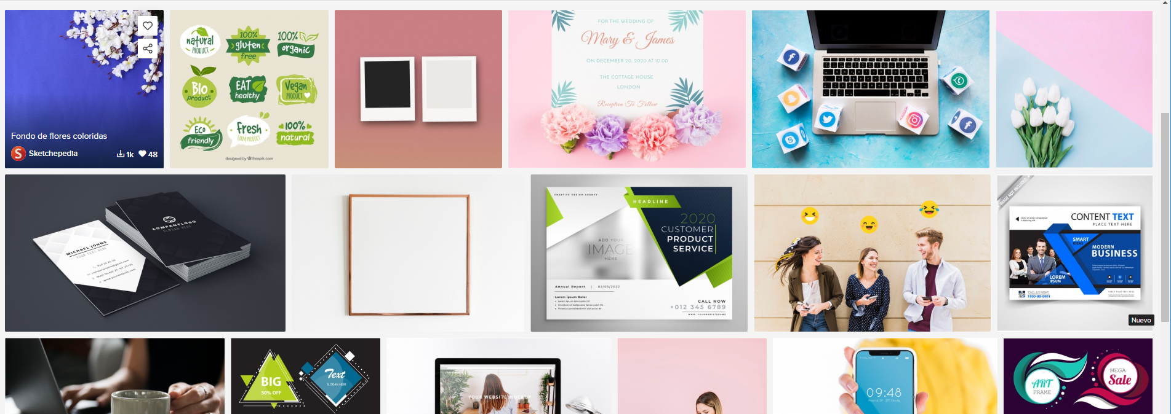
Desktop Software
You can replace the image on the screen with your own work. Just delete this one, add yours and send it to the back

Slide 27
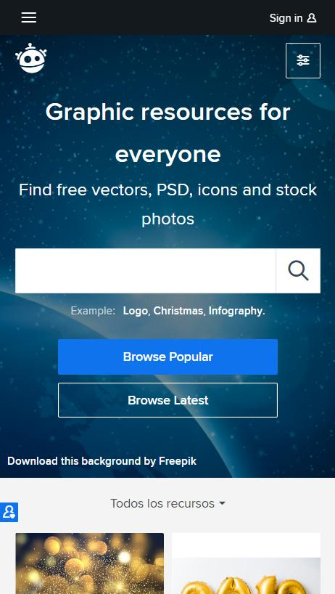
Mobile Web
You can replace the image on the screen with your own work. Just delete this one, add yours and send it to the back

Slide 28
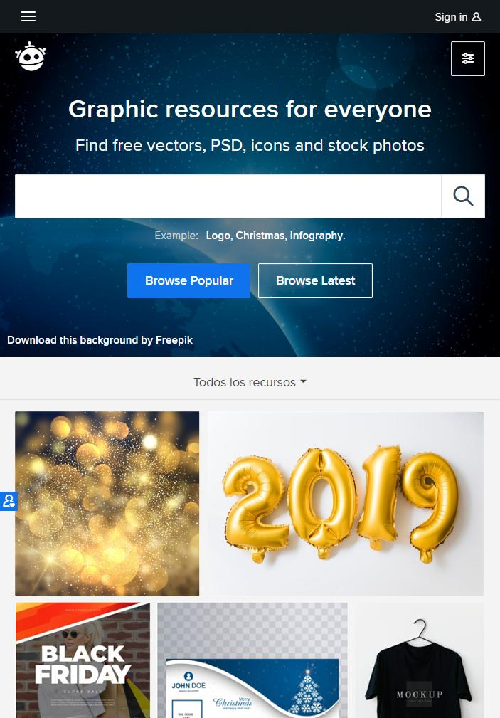
Tablet App
You can replace the image on the screen with your own work. Just delete this one, add yours and send it to the back

Slide 29
Talk about your TEAM
GRAPHIC DESIGNER
CREATIVE
PHOTOGRAPHER
VIDEO EDITOR
Some words about this person
Some words about this person
Some words about this person
Some words about this person

Slide 30
Thanks!
Does anyone have any questions?
addyouremail@freepik.com
+91 620 421 838
yourcompany.com

Slide 31
Credits
This is where you give credit to the ones who are part of this project.
Did you like the resources on this template? Get them for free at our other websites.
Presentation template by Slidesgo
Icons by Flaticon
Images & infographics by Freepik
Author introduction slide photo created by katemangostar - Freepik.com
Big image slide photo created by jcomp - Freepik.com
Text & Image slide photo created by rawpixel.com - Freepik.com
Text & Image slide photo created by Freepik

Slide 32
Instructions for use
In order to use this template, you must credit Slidesgo by keeping the Credits slide.
You are allowed to:
- Modify this template.
- Use it for both personal and commercial projects.
You are not allowed to:
- Sublicense, sell or rent any of Slidesgo Content (or a modified version of Slidesgo Content).
- Distribute Slidesgo Content unless it has been expressly authorized by Slidesgo.
- Include Slidesgo Content in an online or offline database or file.
- Offer Slidesgo templates (or modified versions of Slidesgo templates) for download.
- Acquire the copyright of Slidesgo Content.
For more information about editing slides, please read our FAQs:
https://slidesgo.com/faqs

Slide 33
Fonts & colors used
This presentation has been made using the following fonts:
Ubuntu
(https://fonts.google.com/specimen/Ubuntu)
#8bffffff
#81ececff
#ffffffff

Slide 34
Stories by Freepik
Create your Story with our illustrated concepts. Choose the style you like the most, edit its colors, pick the background and layers you want to show and bring them to life with the animator panel! It will boost your presentation. Check out How it Works.
Pana
Amico
Bro
Rafiki
Cuate

Slide 35
Use our editable graphic resources...
You can easily resize these resources without losing quality. To change the color, just ungroup the resource and click on the object you want to change. Then, click on the paint bucket and select the color you want. Group the resource again when you’re done. You can also look for more infographics on Slidesgo.

Slide 38
JANUARY
FEBRUARY
MARCH
APRIL
MAY
JUNE
PHASE 1
Task 1
Task 2
PHASE 2
Task 1
Task 2
JANUARY
FEBRUARY
MARCH
APRIL
PHASE 1
Task 1
Task 2

Slide 41
...and our sets of editable icons
You can resize these icons without losing quality.
You can change the stroke and fill color; just select the icon and click on the paint bucket/pen.
In Google Slides, you can also use Flaticon’s extension, allowing you to customize and add even more icons.

Slide 42
Educational Icons
Medical Icons

Slide 43
Business Icons
Teamwork Icons

Slide 44
Help & Support Icons
Avatar Icons

Slide 45
Creative Process Icons
Performing Arts Icons

Slide 46
Nature Icons

Slide 47
SEO & Marketing Icons

Slide 48


